Slide 1

Polyglot Persistence
#DecodedConf
David Makogon, Microsoft
@dmakogon

Slide 2
Brain food…
The data landscape
Azure and data
The database types
Polyglot persistence

Slide 3
The Data Landscape

Slide 4
So much data!
90% of the world’s data has been created in the last two years….
George Lee. Chief Information Officer, Investment Banking Division, Goldman Sachs

Slide 5
Data growth
130 billion gigabytes in 2010
4.4 zettabytes* in 2013
IDC projections:
44 zettabytes by 2020
180 zettabytes by 2025
* 1 Zettabyte = 1 trillion gigabytes

Slide 6
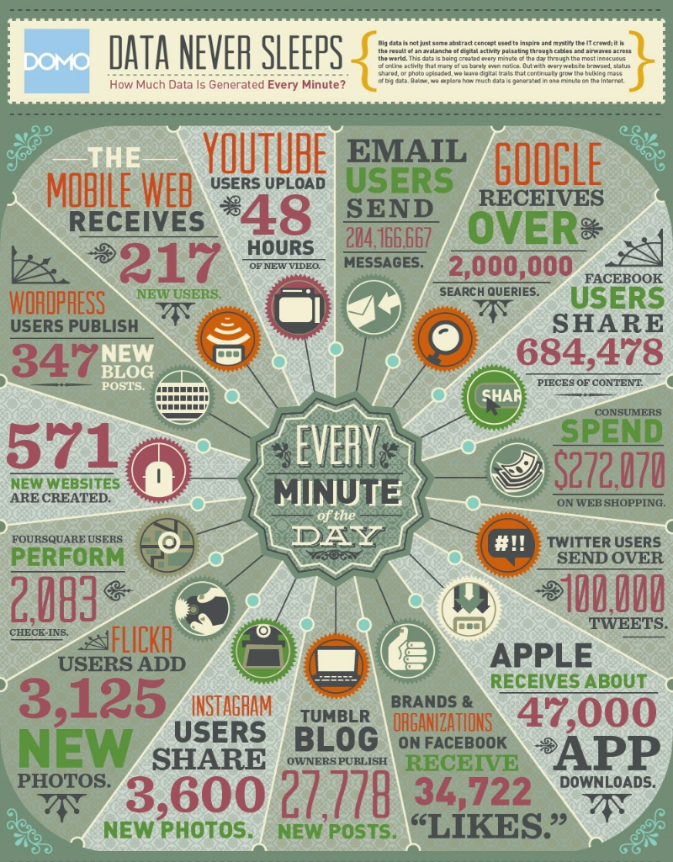
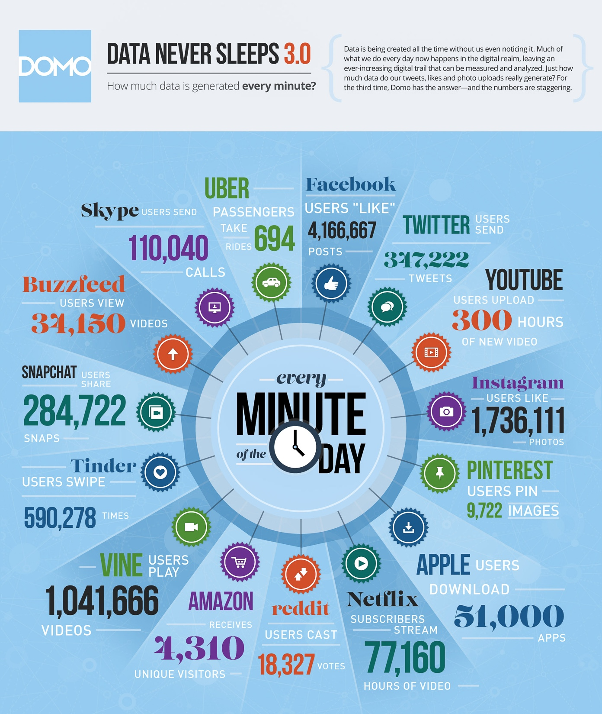
 | 2012 | 2015
YouTube | 48 hours | 300 hours
Twitter | 100,000 tweets | 347,000 tweets
Instagram | 3,600 shares | 1.7 million likes
Facebook | 684,000 shares | 4.1 million likes
Vine | Non-existent | 1 million views
Snapchat | Non-existent | 285,000 snaps
Tinder | Non-existent | 590,000 swipes
Data generated per minute:

Slide 7
The shape of data
Data varies in structure:
Structured, Semi-Structured, unstructured
Maybe related to other data; maybe self-contained
May be transactional or aggregated
How do we fit our data into our favorite database?

Slide 8

The shape of data
Golden Hammer anti-pattern:
When all you have
is a hammer…
Jennifer Boyer – “Nails" - https://flic.kr/p/7J9mJQ

Slide 9
Avoiding the Golden Hammer
NoSQL: It’s not just about Relational anymore
Multiple database categories and data shapes
Relational
Document
Key/Value
Graph
Column
Notes:
NoSQL – even though that term is so overused and completely misses the point

Slide 10
Key/value databases

Slide 11
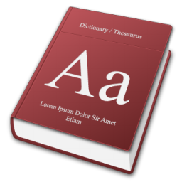
What’s a key/value store?
Effectively, this ->
You search for a Key to find an opaque value

Slide 12
Why use a Key/Value store?
Very rapid, discreet look-ups
When you always know the Key
When you only ever query by Key

Slide 13
Less optimal?
Searching on properties within the Value
Complex queries

Slide 14
Options in Azure?
PaaS
Azure Table Storage
Redis Cache service
IaaS
Redis
Riak
Memcached
And so many more ….

Slide 15
Demo – key/value database

Slide 16
Document databases

Slide 17
What’s a document database?
NOT for this kind of document !

Slide 18
What’s a document database?
{
“id": “13244_user",
"firstName": "John",
"lastName": "Smith",
"age": 25,
"address":
{
"streetAddress": "21 2nd Str",
"city": "New York",
"state": "NY",
"postalCode": "10021"
},
“mobileNumber": "212 555-1234"
}
For this kind of document -

Slide 19
Developer Appeal
Promotes code first development
Resilient to iterative schema changes
Richer query and indexing (compared to KV stores)
Low impedance as object / JSON store; no ORM required
I
developers

Slide 20
Use Cases and Applicability
Mobile and Web
User data store
IoT scenarios
Event workflow and logging
Data ingestion and presentation
Product catalogs
Notes:
Mobile and Web apps – metadata for content oriented apps
User data store – user profile and behavior data
IoT scenarios – queryable device and event store
Event workflow and logging
Data ingestion and presentation – ingesting data with variable schema with rich views over the data
Product catalogs

Slide 21
Less optimal use
Complex relational data
Complex map/reduce aggregations
Distributed transactions
OLAP

Slide 22
Options in Azure?
PaaS
Azure DocumentDB
mLab, MongoDB, Compose
RavenHQ
Iaas
MongoDB
CouchDB
Couchbase
ArangoDB
And countless more …

Slide 23
Example query: DocumentDB
SELECT * FROM f WHERE f.id = "AndersonFamily"
var query = from f in client.CreateDocumentQuery<Family>(collectionLink)
where f.Id == "AndersonFamily"
select f;

Slide 24
Demo – document datatabase

Slide 25
Graph databases

Slide 26
What’s a graph database?
Nodes and relationships
And properties
And all the query stuff

Slide 27



What’s a graph database?
Maybe I should see that movie…
I reviewed that movie!
Reviewed
Friends with

Slide 28
Why a graph database?
Ideal for complex connections
Easy navigation between things (nodes)
No need for complex joins
Easy to add to, and evolve, existing model

Slide 29
Why a graph database?
Less-than-optimal:
Complex relational data
OLAP

Slide 30
Options in Azure?
PaaS
Graph Story
GrapheneDB
IaaS
Neo4j
Dex
OrientDB
InfiniteGraph
AllegroGraph
And many more!

Slide 31
Example query: Neo4j
(ryan:Person)-[:FRIENDS_WITH]->(david:Person)
-[:REVIEWED]->(movie:Movie {Title:’Fletch’})

Slide 32
Demo – graph database

Slide 33
Column databases

Slide 34
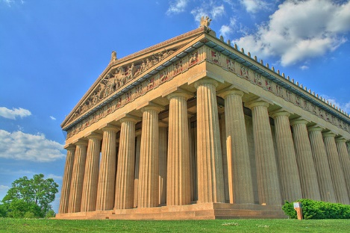
Column stores
Not these columns:
Will Powell – “Nashville Parthenon – HDR” - https://flic.kr/p/2k8TxH

Slide 35
What’s a column store?
Data is keyed by row (e.g. Twitter ID)
Individual content stored as columns
Groups of columns comprise a column family

Slide 36
Example: Weather data
Data is keyed by row (e.g. weather station ID)
Columns may have standard or custom names
For weather: Each col name = date
stationID | Timestamp temp | Timestamp temp | Timestamp temp | …
stationID | Timestamp temp | Timestamp temp | Timestamp temp | …

Slide 37
Why a column family? Why not?
Optimal:
Very large quantities of data
Queries well-known up-front
Scale and durability
Non-optimal:
Highly-relational data
Querying on many different properties

Slide 38
Options in Azure?
IaaS
Cassandra
HBase

Slide 39
Using Cassandra + CQL
CREATE TABLE temperature (
stationID text,
readingtime timestamp,
temp text,
PRIMARY KEY (stationID,readingtime)
);
INSERT INTO temperature(stationID,readingtime,temp)
VALUES (‘1’,’2015-02-23 09:00:00′,’45F’);

Slide 40
Finding temperatures
SELECT readingtime,temp
FROM temperature
WHERE stationID=’1’;

Slide 41
Polyglot persistence

Slide 42
Choices, choices, choices!
Relational
Key/value
Graph
Column
Document
Ready… set… CHOOSE!
Hmmm… Not so easy, eh?

Slide 43
Why so difficult to pick one?
Schema enforcement
Reporting
Interconnections
Time-series
Rapid lookup
Scale-out
Scale-up
Durability

Slide 44
Compromises when picking just one database
Referential integrity & transactions
Schema flexibility
Scale
Reporting
Skillsets
HA/DR procedures
3rd-party tools and the ecosystem

Slide 45
Do we have to compromise?
Combine!
Why not?
Maybe… a bit of each?

Slide 46



Imagine… a shopping site
E-Commerce platform
Cart
Orders
Catalog & Reviews
Suggestions
Key/value
RDBMS
Document
Graph

Slide 47
Challenges?
Multiple DB skillsets
More complex HA/DR/Backup procedures
Additional licensing and support
Determining System(s) of Record

Slide 48
Challenges challenged
What’s the effort and cost for?
Avoiding the Golden Hammer
INSERT INTO ROUND_HOLE
VALUES (‘SQUARE_PEG’)

Slide 49
Benefits
Use each database type for its strengths
Reduce scope and complexity with a database type

Slide 50
The shape of data
90% of the world’s data has been created in the last two years….
The ultimate question is really what insight and value can we draw from that data.

Slide 51
Questions?

